Slide 1
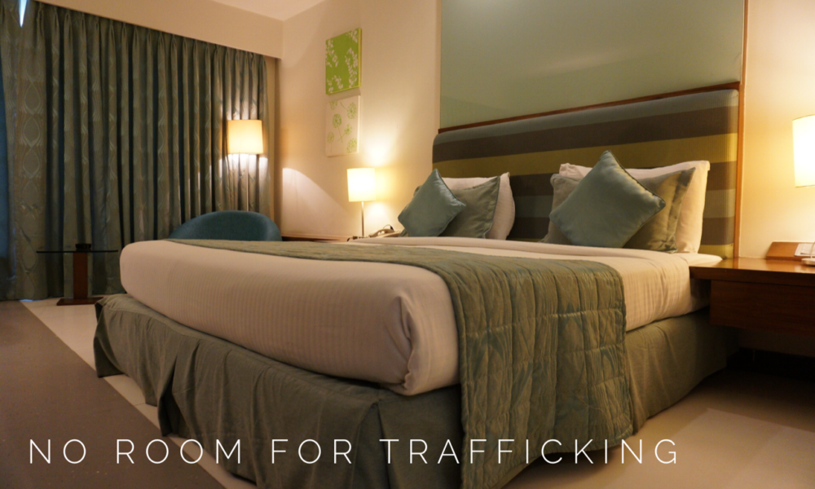
Hotels Against Trafficking
By: Ngoc Tran
Thursday, September 12, 2019
Notes:
Image Source: https://talk1073.com/2019/08/12/no-room-for-trafficking/

Slide 2
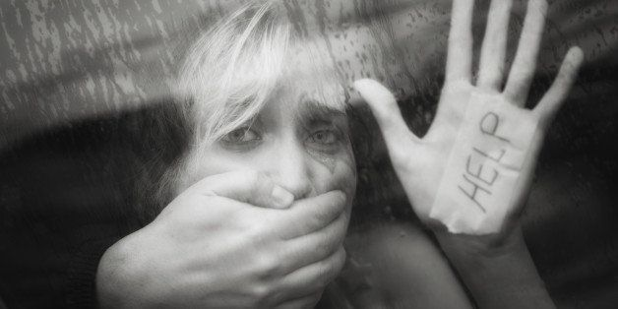
Motivation
In the United States alone:
Approximately 75-80% of human trafficking and slavery is for sex
30,000 people die each year while being trafficked for sex from neglect, abuse, disease, or torture
Nearly 20,000 victims are sold and trafficked each year. This number includes the victims who are as young as 5 and 6 years of age
There have been approximately 100,000 to 150,000 sex slaves since 2001
Source: The Disturbing Reality of Human Trafficking and Children (Dec 18, 2016)

Slide 3
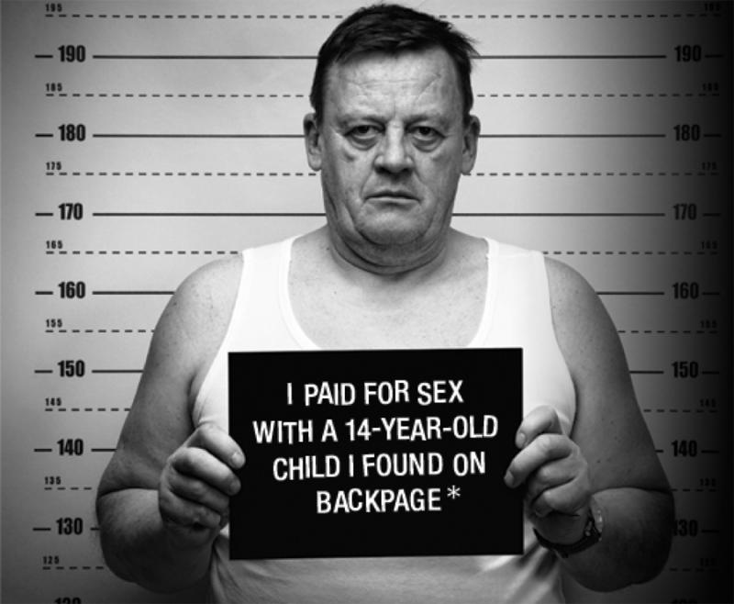
Objectives
Problem:
Commercial sex within hotels and motels are most frequently advertised through online platforms (Backpage.com, Eros.com, etc.)
Goal:
Automatically classifying different hotel chains using Deep Learning
Source: The National Human Trafficking Hotline
Notes:
Image Source: https://www.knkx.org/post/seattle-confronts-child-prostitution-problem-after-fbi-sweeps
Websites such as Backpage.com, Eros.com, and others are used as a platform for advertising the women, men, and youth engaged in commercial sex as well as a communication tool for setting up dates, times, and locations.

Slide 4



Images
3 hotel chains:
Two-star hotel chain, Comfort Inn
Three-star hotel chain, Best Western
Four-star hotel chain, Hilton
Training set:
4,000 (128,128,3) images per hotel chain
Validation set:
1,000 (128,128,3) images per hotel chain
Test sets:
Images are augmented with person-shaped masks of varying size splitted into 4 categories, each contains the same:
388 (128,128,3) Comfort Inn images
384 (128,128,3) Best Western images
249 (128,128,3) Hilton images
Source: A Global Hotel Recognition Dataset
Notes:
Image Sources:
[1] https://www.choicehotels.com/comfort-inn
[2] https://www.bestwestern.com/en_US.html
[3] https://www.hilton.com/en/hilton/
Images are scraped from:
Publicly available travel websites, such as Expedia
Crowdsourcing mobile application, TraffickCam, which enables travelers to help combat sex trafficking by uploading photos of the hotel rooms they stay in
To replicate real-world conditions, the images in the test set are augmented with person-shaped masks of varying size.

Slide 5
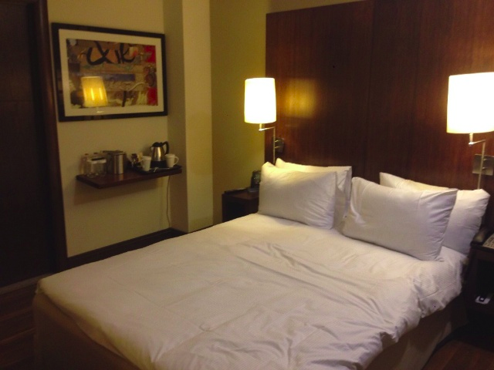
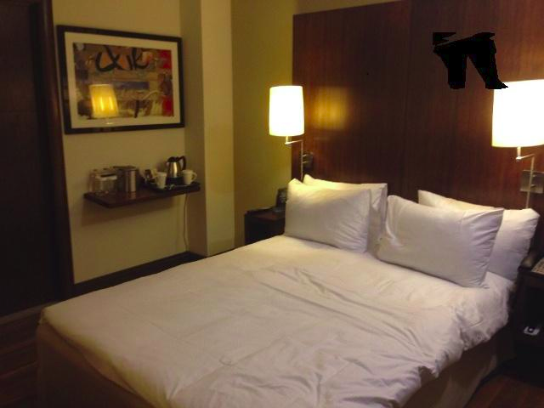
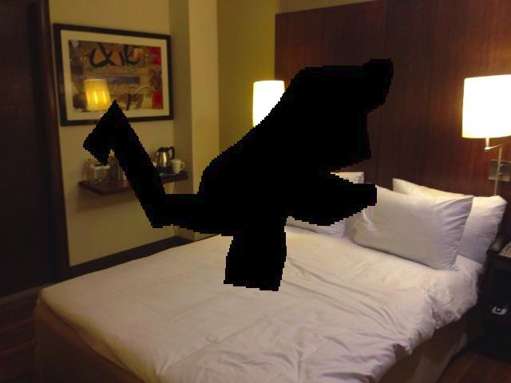
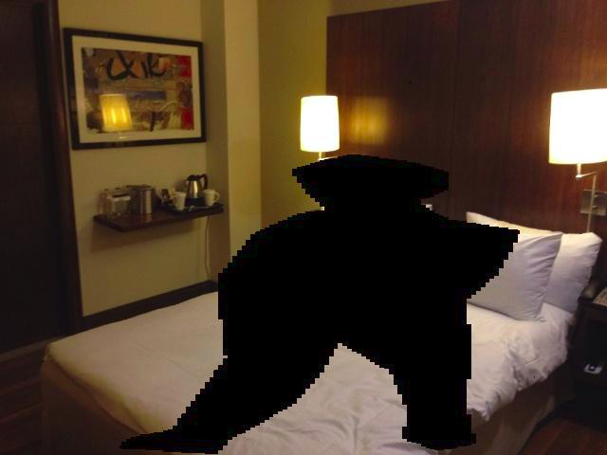
Test Sets
Unoccluded
Low Occlusions
Medium Occlusions
High Occlusions

Slide 6
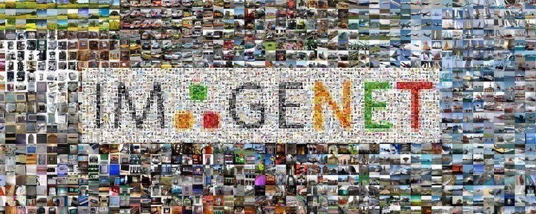
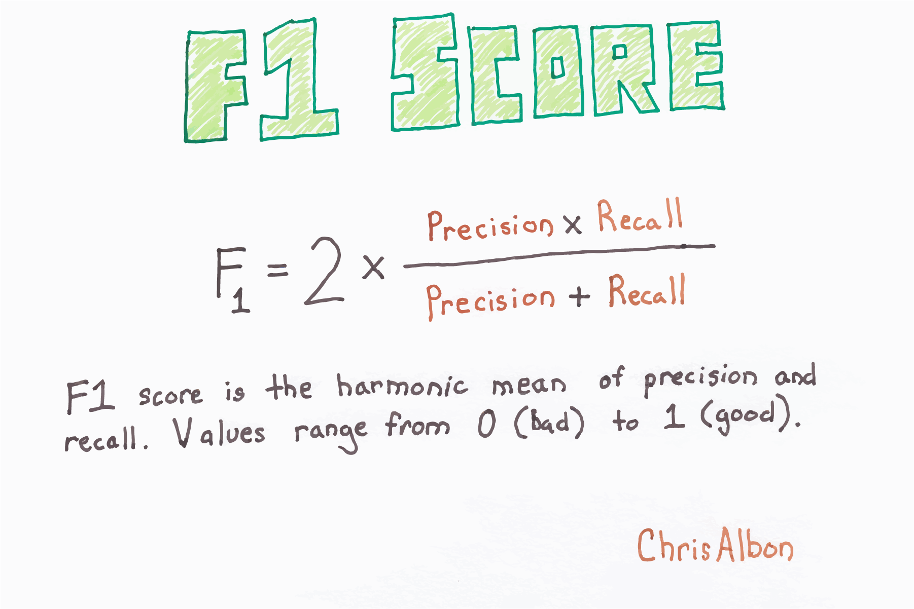
Best Model & Metrics
Best Model:
VGG-16 Deep Convolutional Neural Network pre-trained on ImageNet database
Last 5 layers unfrozen to allow for additional training on hotel chain database
Metrics:
Precision:
What proportion of positive identifications was actually correct?
Recall:
What proportion of actual positives was identified correctly?
F1-Score:
The harmonic mean of Precision and Recall
Source: Classification: Precision and Recall
Notes:
Image Sources:
[1] https://gluon-cv.mxnet.io/build/examples_datasets/imagenet.html
[2] https://chrisalbon.com/machine_learning/model_evaluation/f1_score/
ImageNet is a dataset of over 15 millions labeled high-resolution images with around 22,000 categories. It is widely used in the research community for benchmarking state-of-the-art models.
Precision allows us to answer the following question: "Out of all the times the model says ‘this is a Hilton hotel,’ how many times are those hotels actually Hilton?"
Recall allows us to ask: "Out of all the Hilton hotels, what percentage of them does our model correctly identify as Hilton hotels?"
F1-Score cannot be high without both precision and recall also being high. High F1-Scores allows for more victims to be rescued while wasting less efforts of the authorities.

Slide 7
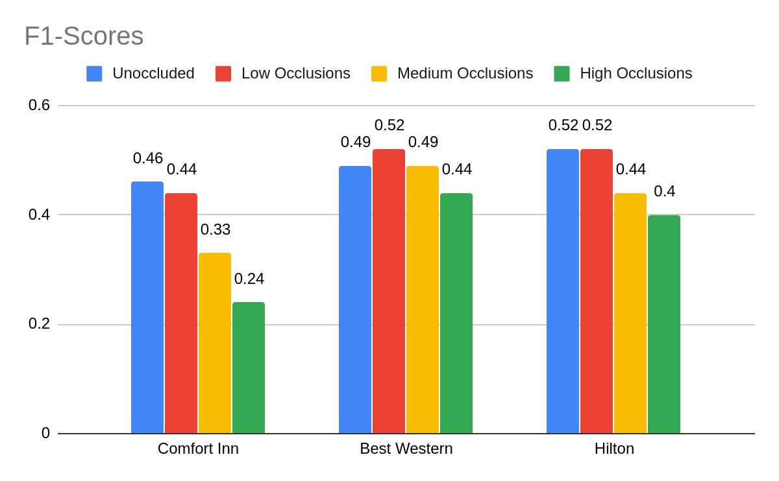
Results
Notes:
Since we have a perfectly balanced dataset with 3 classes, an F1-score of larger than 33% is better than random.

Slide 8
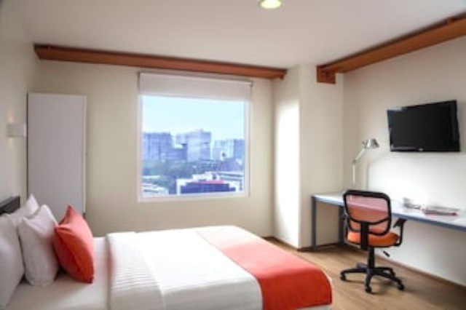
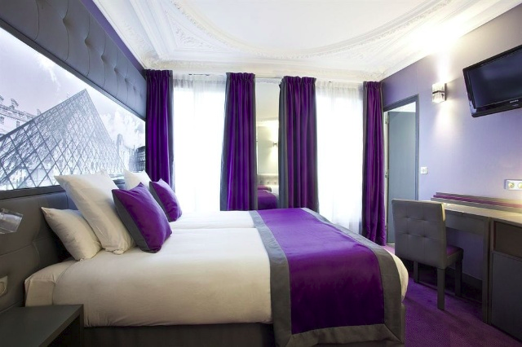
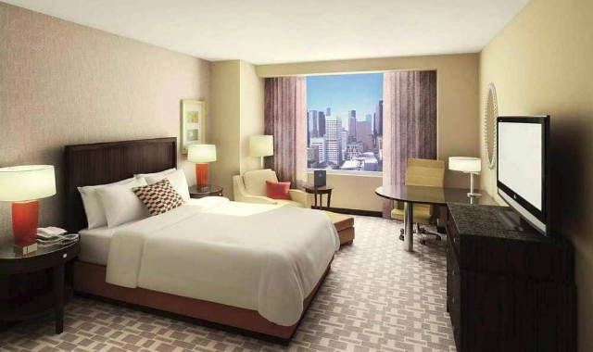
Difficulties
Comfort Inn
Best Western
Hilton

Slide 9
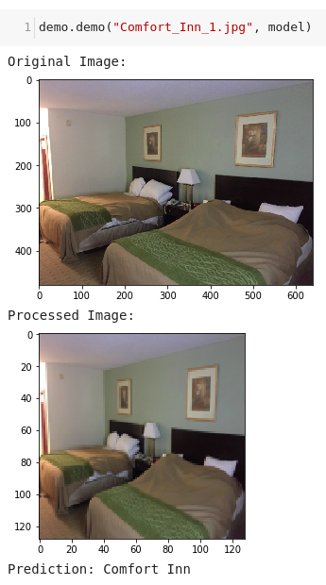
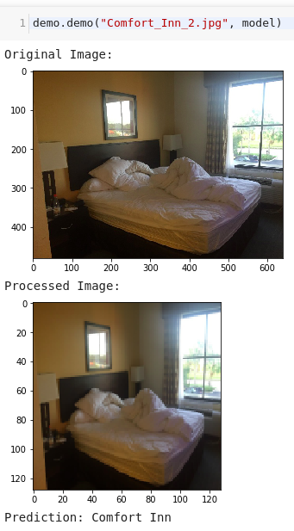
Demo - Comfort Inn

Slide 10
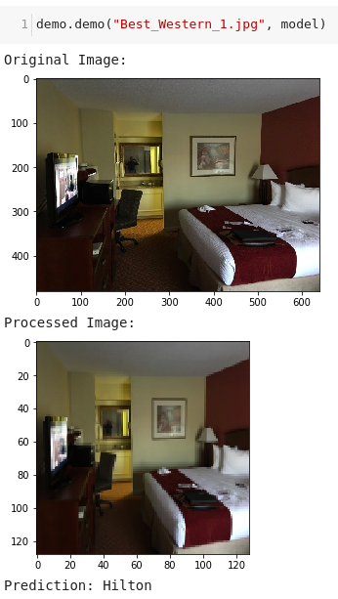
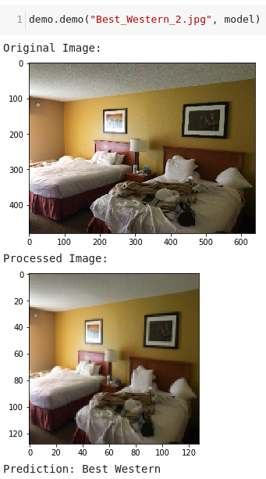
Demo - Best Western

Slide 11
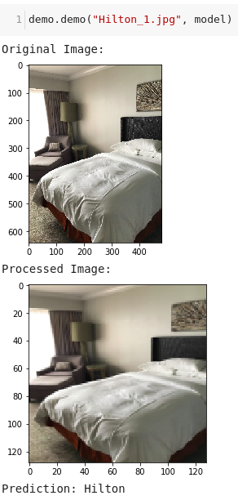
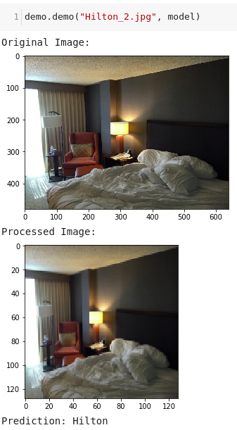
Demo - Hilton

Slide 12

Next Steps for Future Improvements
Further fine-tuning the best model
Further fine-tuning other Deep Convolutional Neural Network models
Notes:
Image Source: Fine-tuning XGBoost in Python like a boss

Slide 13
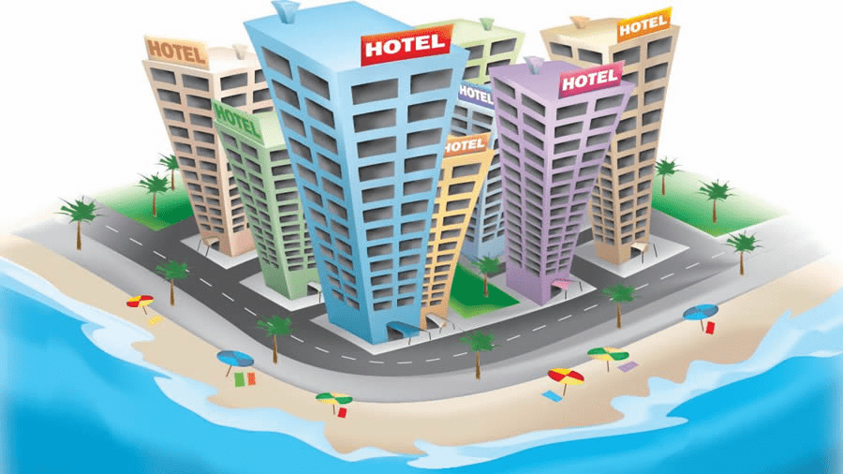
Future Plans
Automatically classifying different hotels and motels using Deep Learning
Notes:
Image Source: https://zualetech.com/zuotel-hotel-booking-and-management-system/

Slide 14
Questions?

Slide 15
THANK YOU!

Slide 16
Sources
https://keras.io/models/sequential/
https://keras.io/applications/
https://keras.io/callbacks/
https://keras.io/layers/core/
https://keras.io/layers/normalization/
https://keras.io/utils/
https://scikit-learn.org/stable/modules/generated/sklearn.model_selection.train_test_split.html
https://scikit-learn.org/stable/modules/model_evaluation.html#classification-metrics
https://pypi.org/project/opencv-python/

Slide 17
Contact Information
GitHub: https://github.com/nt-ds/hotels-against-trafficking
LinkedIn: https://www.linkedin.com/in/nt-ds/
Email: ntran19@jhu.edu
Medium: https://medium.com/@ntran19

